Slide 1
Know your students
You absolutely MUST know the students that you are teaching. It is YOUR job to make sure that the students in your class are learning, nobody else’s!

Slide 2
SEN
CAT scores
Current level
Target level
What do they mean?

Slide 3
Questioning is at the heart of good teaching:
Get to know your students; use the data and talk to them, and ask the right students the right question!

Slide 4
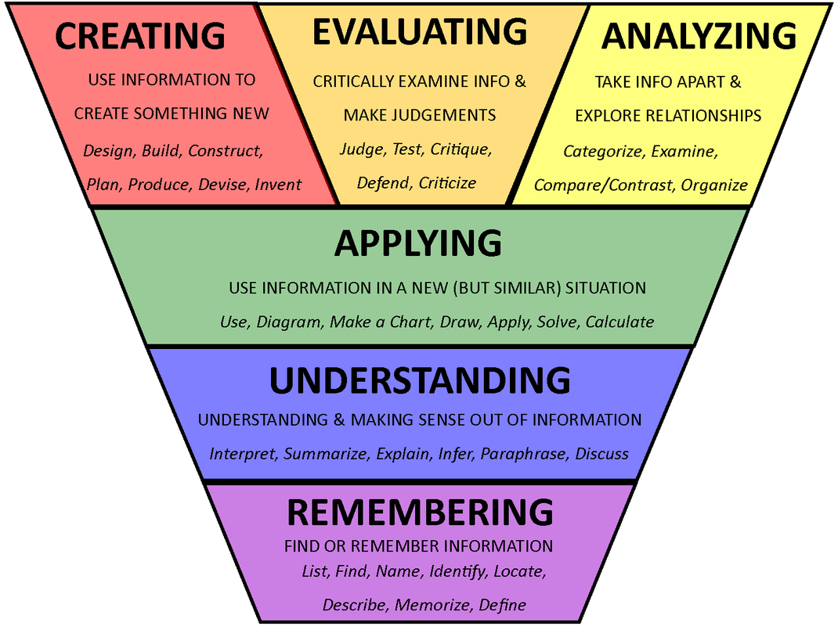

Slide 5
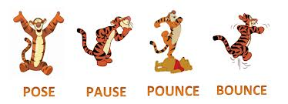
SHARE

Slide 6
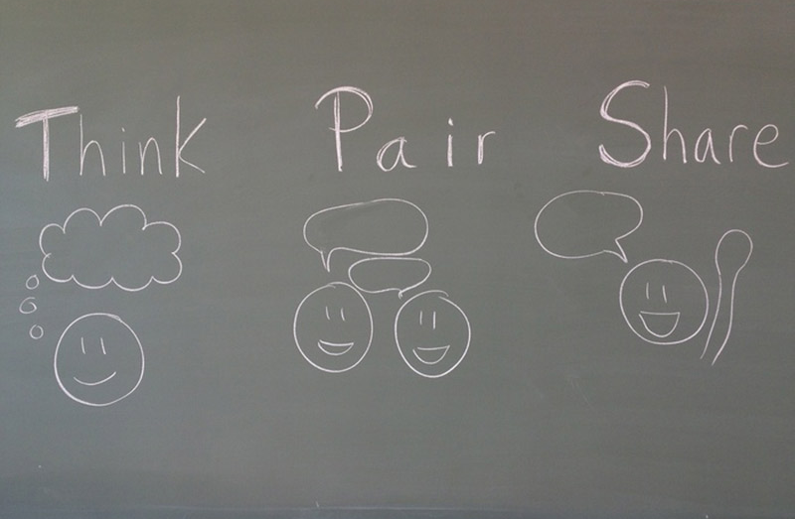
Questioning

Slide 7
What is the best question in the World…EVER!!!

Slide 8
1. What do you think?
2. Why do you think that?

